Slide 1
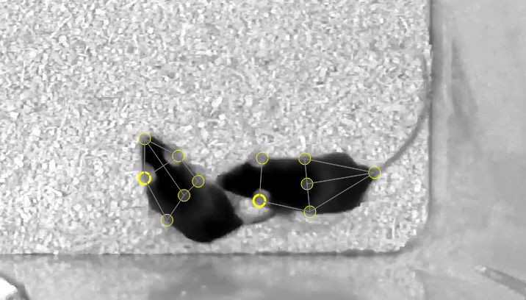
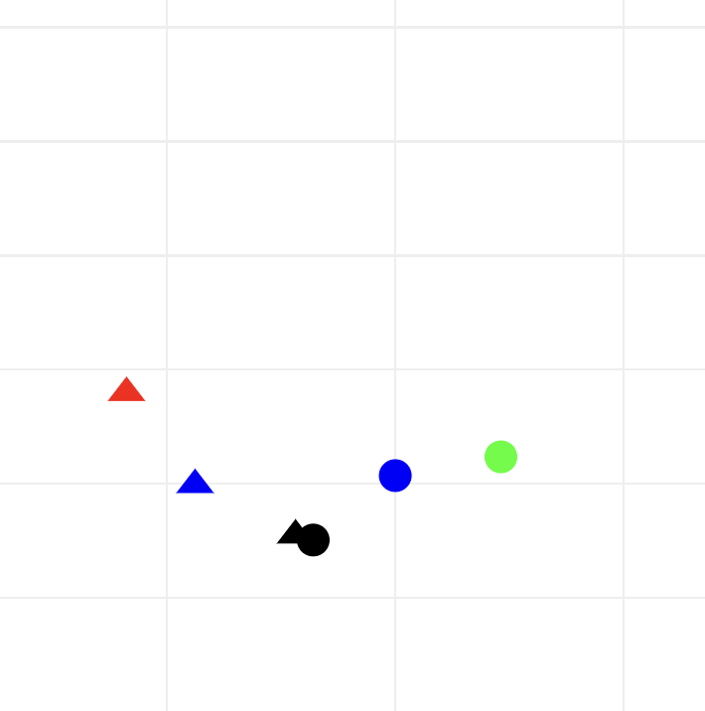
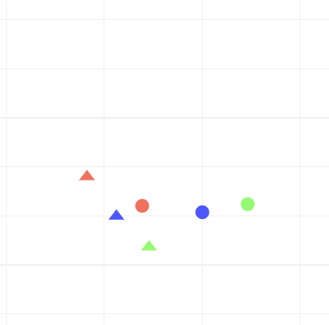
SLEAP and SimBA Pipeline for High-Resolution Mouse Social Behavior Analysis
1. SLEAP-Based Pose Tracking
NN Training on 40 manually annotated frames
2. R Tracking & Smoothing Boosts Accuracy
Tune parameters to minimize prediction MSFE
Pose Tracking → EKF Smoothing
Intruder Experiment
Rules ensure motion continuity over time
Linearized priors ensure realistic skeletons
Kalman smoothing fills in missing predictions
Raw poses are inaccurate for huddling mice

Slide 2
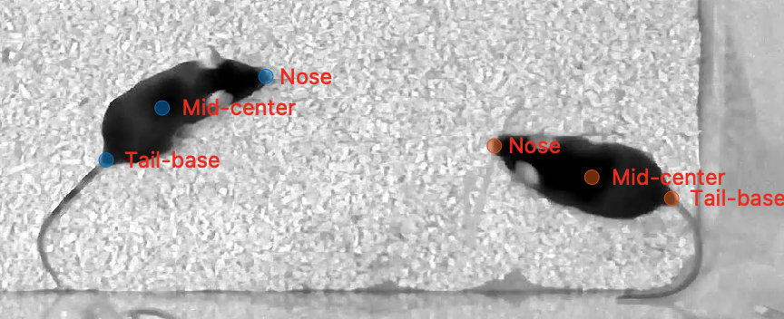
3. Correct Identities and Import to SimBA
Attach predictions to video, correct identity swaps
Transform predictions to wide .csv file for SimBA
Extract mouse distance and movement features

Slide 3
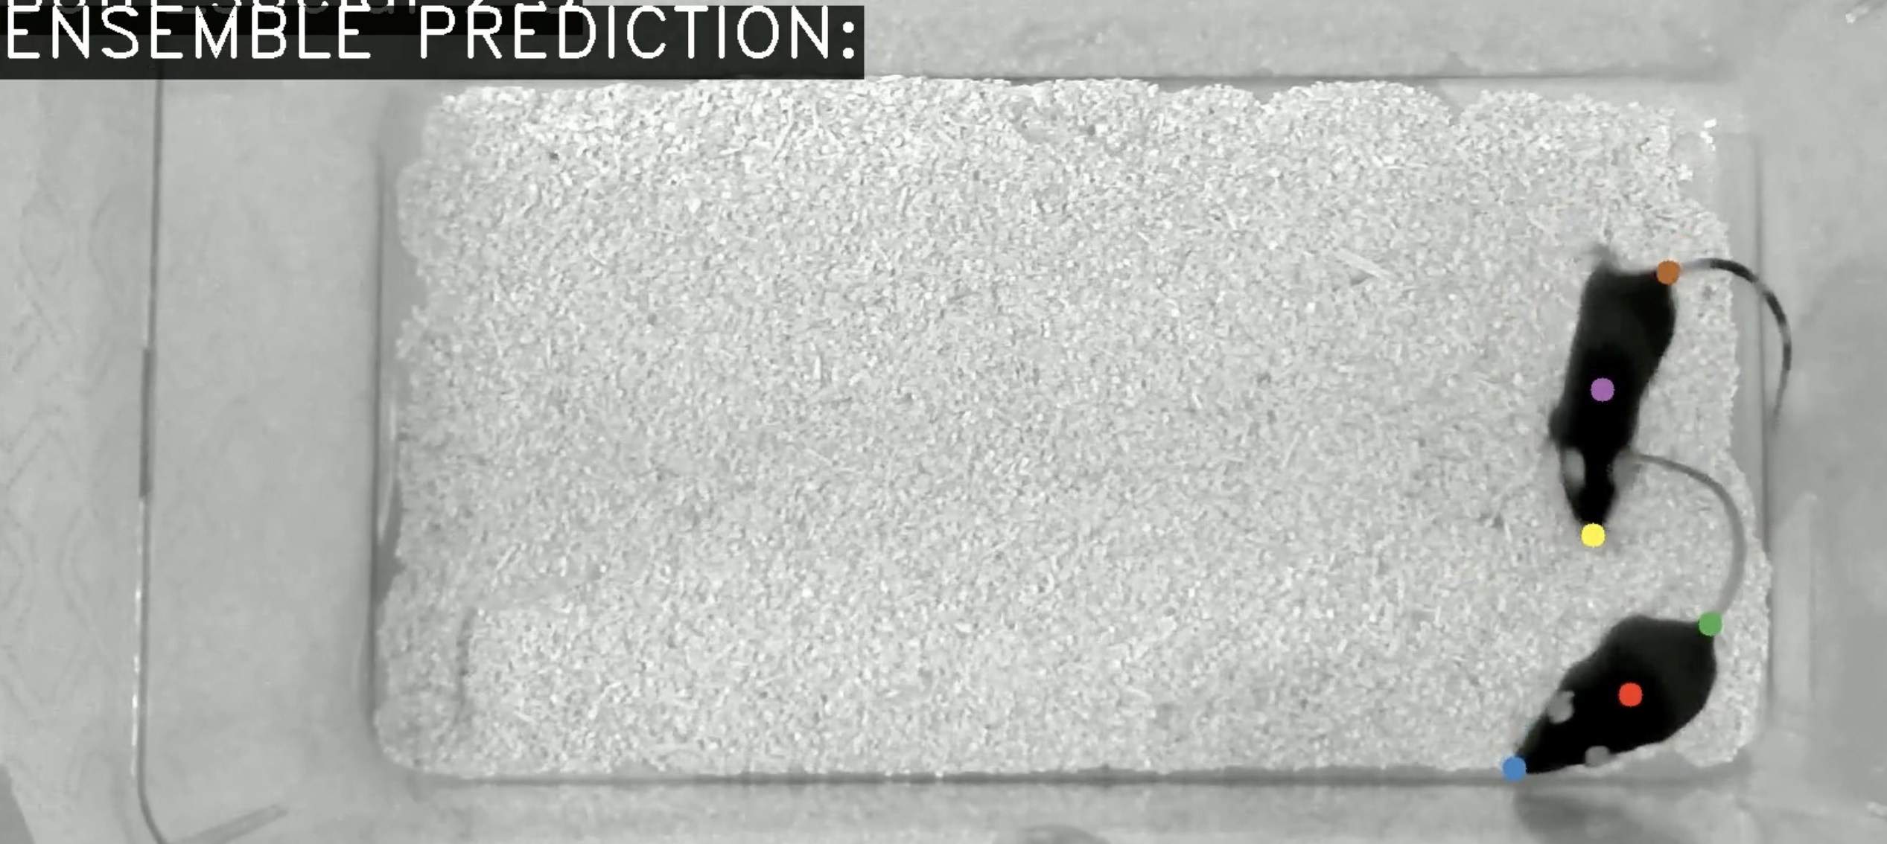
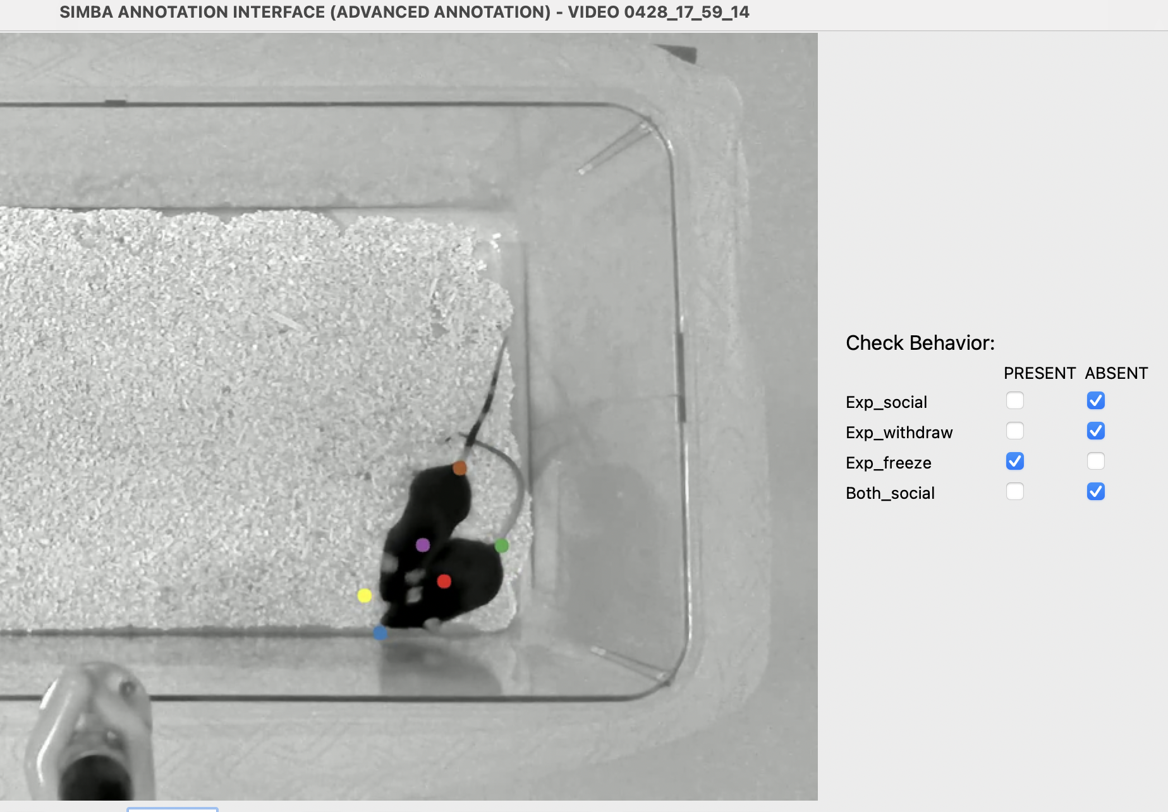
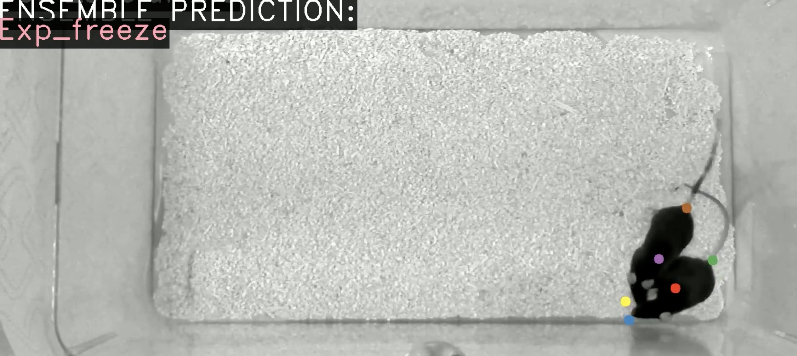
5. Validation and Initiative Labelling
4. SimBA Social Behavior Machine Learning
Classify social and freeze/withdraw behavior
Manually annotate 3 minutes of each video
Validate behaviors and determine which mouse initiates behavior by approaching

Slide 4
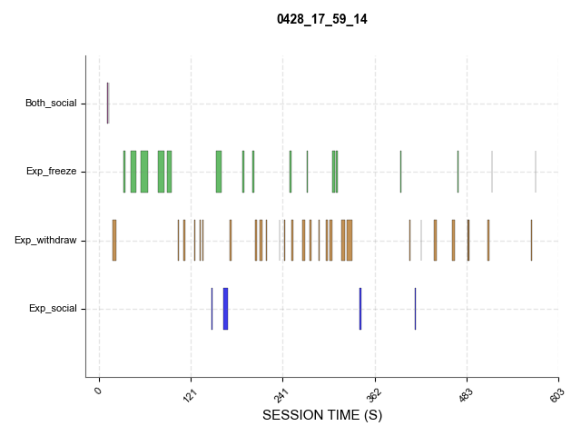
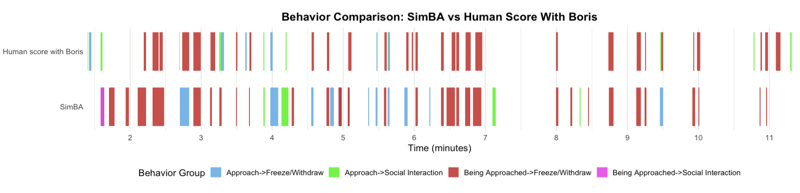
6. Validation vs. Human Scoring with Boris
Obtain Gantt charts and align with human scoring

